Slide 1
Using NHANES to examine relationships between household smokers and depressive symptoms, diabetes, and cholesterol level
Valeria Fraga, Mackenzie Lamb, and Hunter Mckeon
Faculty Advisors: Howard Cabral and Jacqui Hicks
2022 Summer Institute in Biostatistics and Data Science
Boston University
Notes:
Using NHANES to examine relationships between household smokers and depressive symptoms, diabetes, and cholesterol level

Slide 2
What is NHANES?
National Health and Nutrition Examination Survey
Part of the Centers for Disease Control and Prevention (CDC) and National Center for Health Statistics (NCHS)
Study designed to assess the health and nutrition status of adults and children in the United States
Approx. 5,000 annual participants selected to represent the US population
NHANES over-samples persons 60 and older, African Americans, and Hispanics to produce reliable statistics
Data collection:
Interview for demographic, socioeconomic, dietary, and health-related information
Examination (including laboratory tests) for medical, dental, and physiological measurements

Slide 3

NHANES 2017-18
Last complete NHANES data collection cycle before the COVID-19 pandemic
16,211 individuals selected to participate
9,254 interviewed
8,704 examined

Slide 4
Research Questions
Is passive cigarette smoke exposure predictive of level of depressive symptoms (PHQ-9) when controlling for alcohol consumption, age, sex, education level, and SES?
Is depressive symptom level predictive of diabetes and/or LDL cholesterol levels when controlling for alcohol consumption, age, sex, education level, and SES?

Slide 5
Variables of Interest
Question 1:
Exposure:
Passive Cigarette Exposure
Outcome
Level of depressive symptoms (PHQ-9)
Question 2:
Exposure:
Level of depressive symptoms (calculated based off PHQ-9)
Outcome:
Diabetes (dichotomous)
Low Density Lipoproteins (LDL) cholesterol (continuous)
Confounding Variables:
Alcohol consumption - Education level
Age - Socioeconomic Status
Sex

Slide 6
Methods of Analysis
Question 1:
Linear Regression
Question 2:
Logistic Regression (diabetes)
Linear Regression (LDL cholesterol)
Note:
All statistical analyses incorporated samping weights as well as strata and primary sampling unit variables as design variables.
Notes:
need to use specialized analytic procedures for this complex sample survey that incorporate sampling weights and design effects

Slide 7
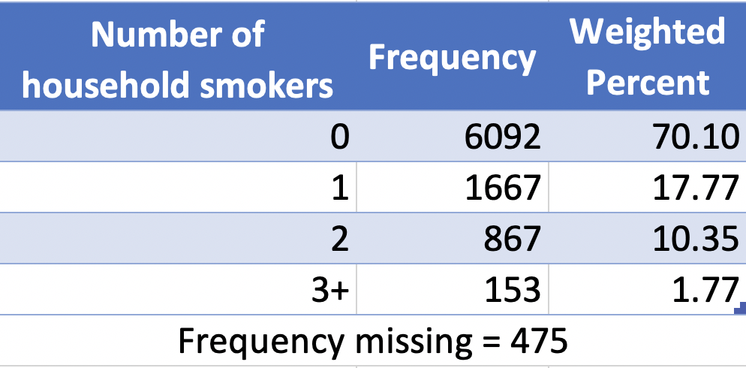
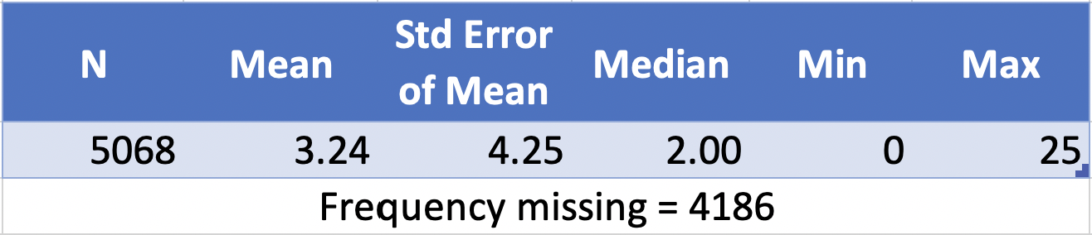
Key variables
Passive cigarette exposure
Number of people in participant’s home who smoke tobacco
Questionnaire data
Level of depressive symptoms
Total score on PHQ-9 depressive symptom screener
9 questions about frequency of symptoms over last 2 weeks
0 = not at all
1 = several days
2 = more than half the days
3 = nearly every day
Questionnaire data

Slide 8
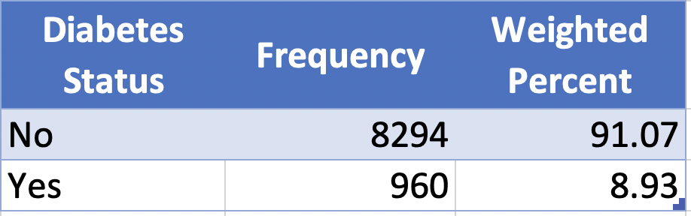
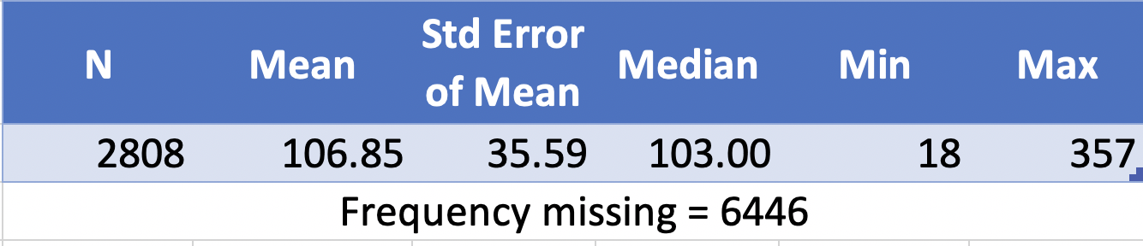
Key variables
Diabetes
Dichotomous variable
Fasting plasma glucose ≥ 126 mg/dL OR currently taking insulin OR currently taking diabetic pills
Laboratory and questionnaire data
LDL cholesterol
Continuous variable
LDL-Cholesterol in mg/dL
Laboratory data

Slide 9
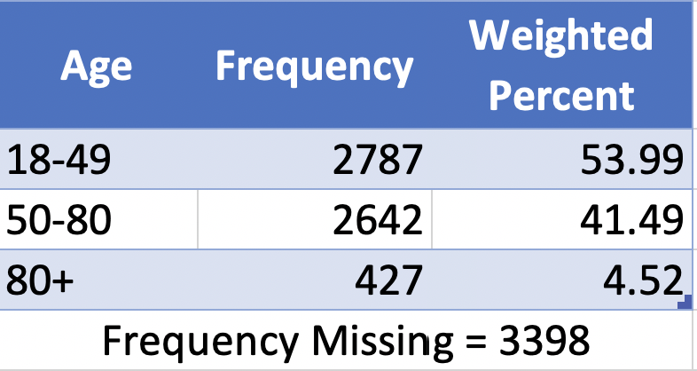
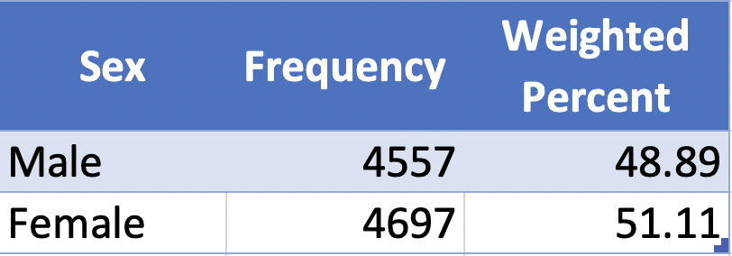
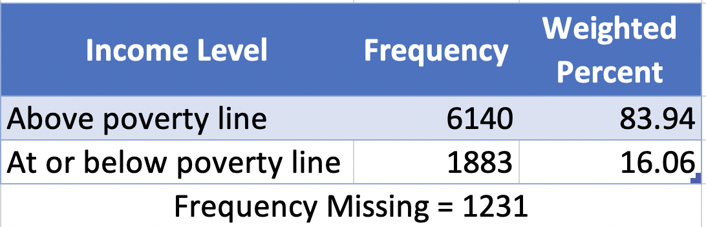
Confounding variables
Age
Demographic data
Sex
Demographic data
Socioeconomic status
Demographic data
Ratio of family income to poverty level

Slide 10
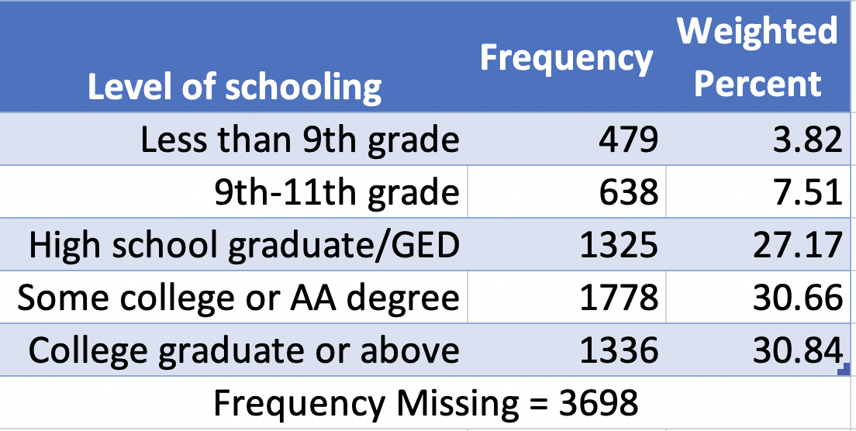
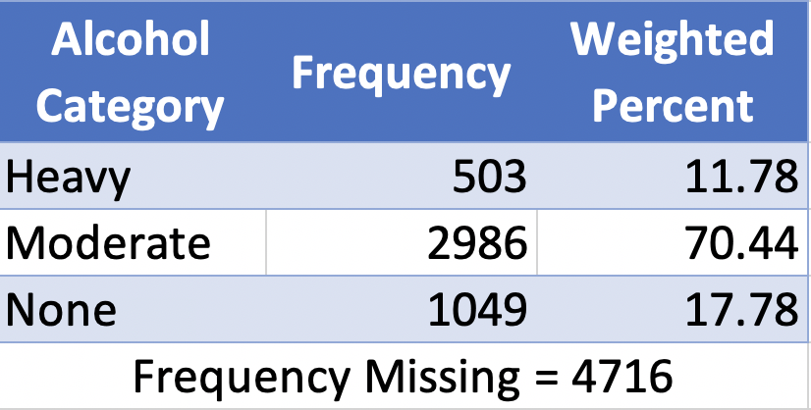
Confounding variables
Alcohol consumption
Definitions from National Institute on Alcohol Abuse and Alcoholism
Moderate
Men: 1-4 drinks per day
Women: 1-3 drinks per day
Heavy
Men: 5+ drinks per day
Women: 4+ drinks per day
Questionnaire data
Education level
Highest level of schooling participant has completed
Demographic data

Slide 11
Model for predicting Depression symptoms
proc surveyreg data=merged;
domain adult;
class homesmokers3 (ref=first) incomelevel alc_cat2 age (ref=first) edLevel (ref=first);
model phq9 = homesmokers3 incomelevel alc_cat2 age edLevel/solution clparm;
weight wtint2yr;
cluster sdmvpsu;
strata sdmvstra;
run;

Slide 12
Model Code Explanation
Proc surveyreg: Ran a regular linear regression
Domain: Grabbed all individuals labeled “Adult” from out dataset
Class: Allows us to build dummy variables for our categorical variables and set reference groups.
Model: Put our outcome variable first then the explanatory variables after the “=” sign. Solution clparm gives us confidence limits for the parameter estimates.
Weight: We used this weight variable because it allows us to accurately represent the population we’re estimating for with the interview data.
Cluster: Masked variance pseudo - PSU
Strata: Masked variance pseudo - stratum

Slide 13
Model for predicting Diabetes
proc surveylogistic data=merged;
domain adult;
class homesmokers3 (ref=first) depression (ref = "Minimal") incomelevel alc_cat2 age (ref=first) edLevel (ref=first) / param=ref;
model DIABTS2 (ref = '0') = homesmokers3 depression incomelevel alc_cat2 age edLevel;
weight wtmec2yr;
cluster sdmvpsu;
strata sdmvstra;
run;

Slide 14
Model Code Explanation
Proc surveylogistic: Ran a logistic regression
Domain: Grabbed all individuals labeled “Adult”
Class: Allows us to build dummy variables for our categorical variables and set reference groups.
Model: Put our outcome variable diabetes first then the explanatory variables after the “=” sign.
Weight: We used this weight variable because it accurately represented the population were estimating with medical examination center data.

Slide 15
Model for predicting Cholesterol
proc surveyreg data=merged;
domain adult;
class homesmokers3 (ref=first) depression (ref = "Minimal") incomelevel alc_cat2 age (ref=first) edLevel (ref=first);
model LBDLDL = depression homesmokers3 incomelevel alc_cat2 age edLevel/solution clparm;
weight wtmec2yr;
cluster sdmvpsu;
strata sdmvstra;
run;

Slide 16
Model Code Explanation
Proc surveyreg: Ran a linear regression
Domain: Grabbed all individuals labeled “Adult”
Class: Allows us to build dummy variables for our categorical variables and set reference groups.
Model: Put our outcome variable cholesterol first then the explanatory variables after the “=” sign. Solution clparm gives us confidence limits for the parameter estimates.
Weight: We used this weight variable because it accurately represented the population were estimating with medical examination center data.

Slide 17

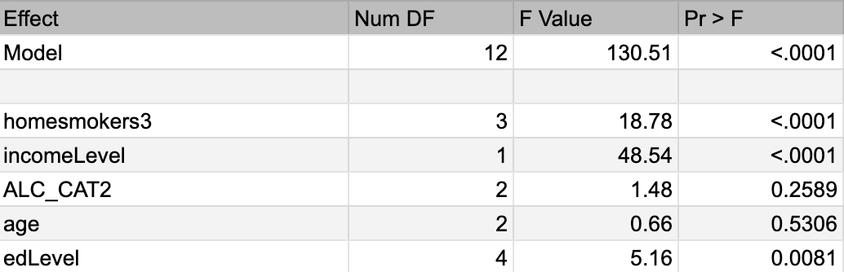
Results: Question 1
Exposure: Passive Smoking
Outcome: PHQ9 Score
Notes:
Passive exposure to smoke, income level, and education level

Slide 18
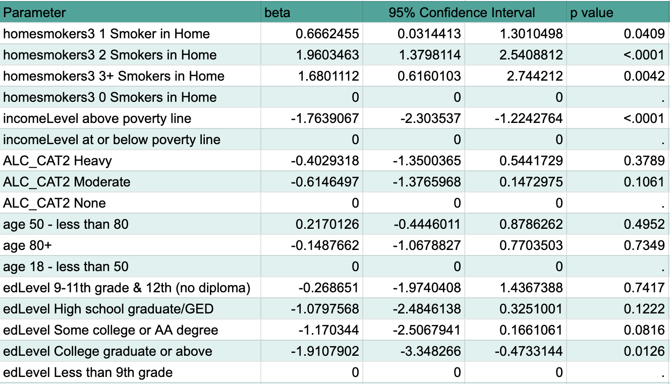
Results: Question 1
Exposure: Passive Smoking
Outcome: PHQ9 Score

Slide 19
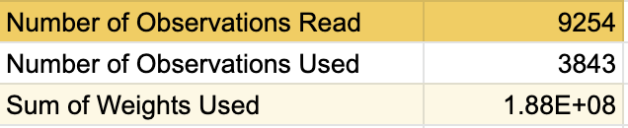
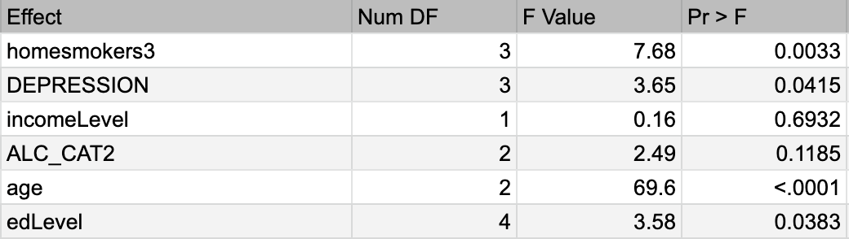
Results: Question 2, Model 1
Exposure: Depressive Symptoms
Outcome: Diabetes
Notes:
Why are there only 3,843 observations used?

Slide 20
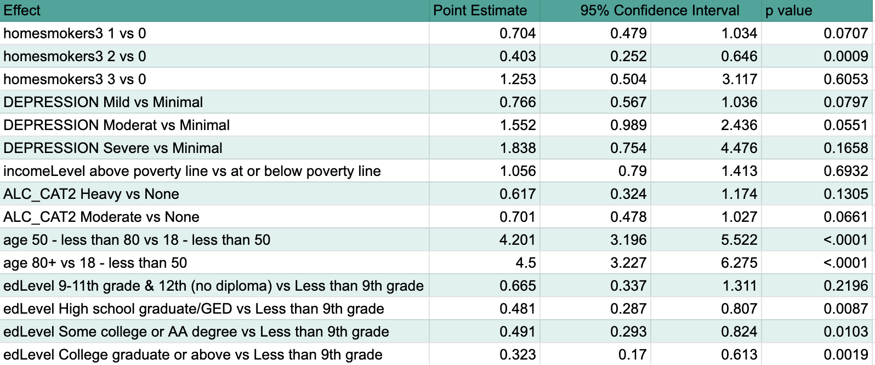
Results: Question 2, Model 1
Exposure: Depressive Symptoms
Outcome: Diabetes
Notes:
EDIT THIS TABLE

Slide 21

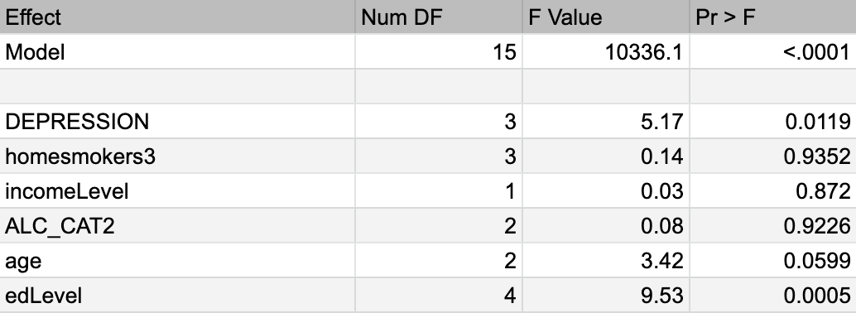
Results: Question 2, Model 2
Exposure: Depressive Symptoms
Outcome: LDL Levels : Friedewald
Notes:
Number of Obs 1762, Sum of Weights 86883464

Slide 22
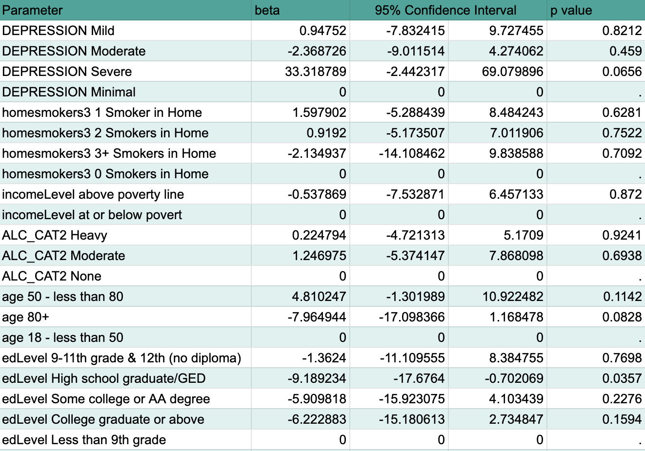
Results: Question 2, Model 2
Exposure: Depressive Symptoms
Outcome: LDL Levels : Friedewald

Slide 23

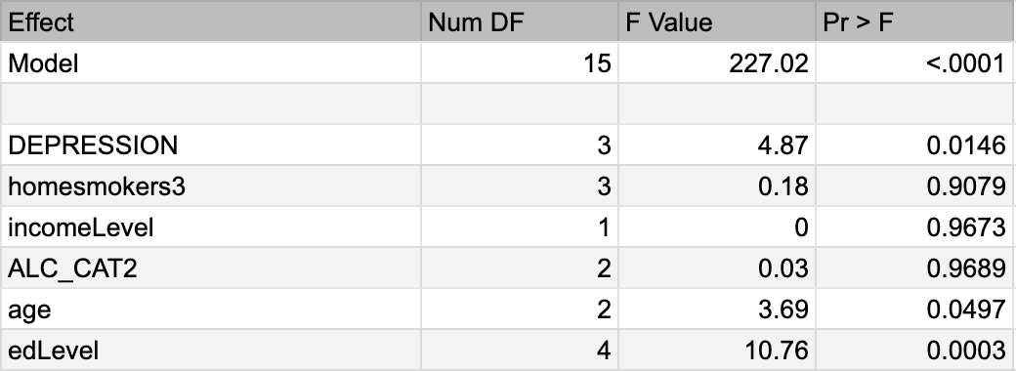
Results: Question 2, Model 2
Exposure: Depressive Symptoms
Outcome: LDL Levels : Martin Hopkins

Slide 24
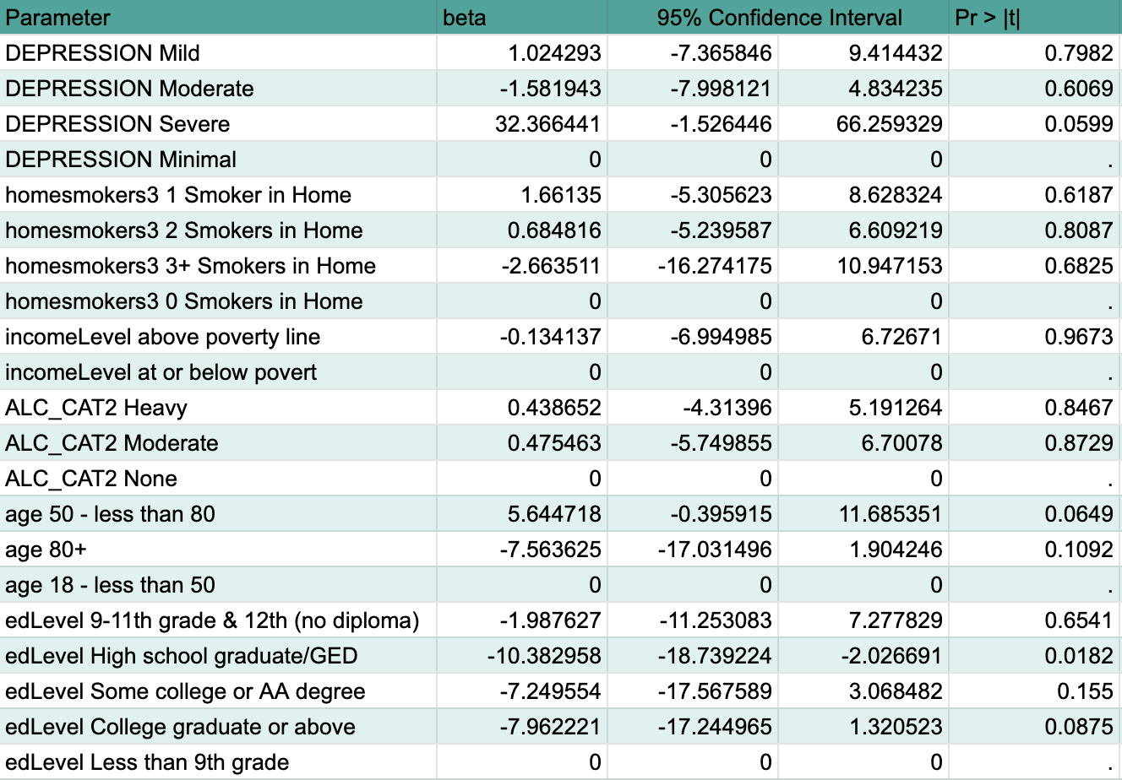
Results: Question 2, Model 2
Exposure: Depressive Symptoms
Outcome: LDL Levels : Martin Hopkins

Slide 25

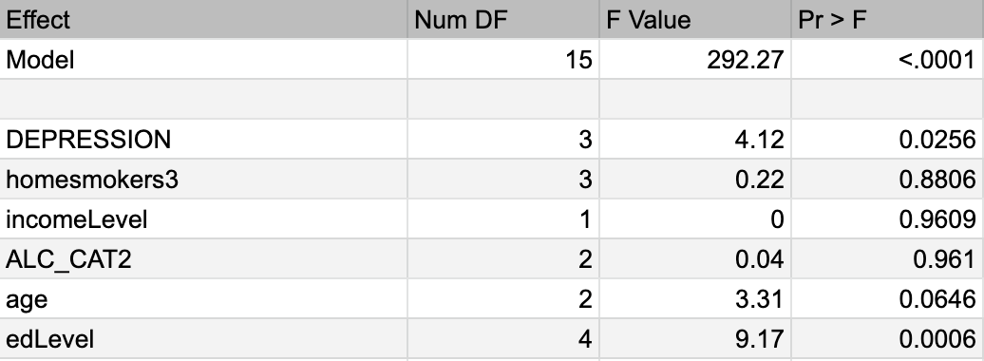
Results: Question 2, Model 2
Exposure: Depressive Symptoms
Outcome: LDL Levels : NIH Equation 2

Slide 26
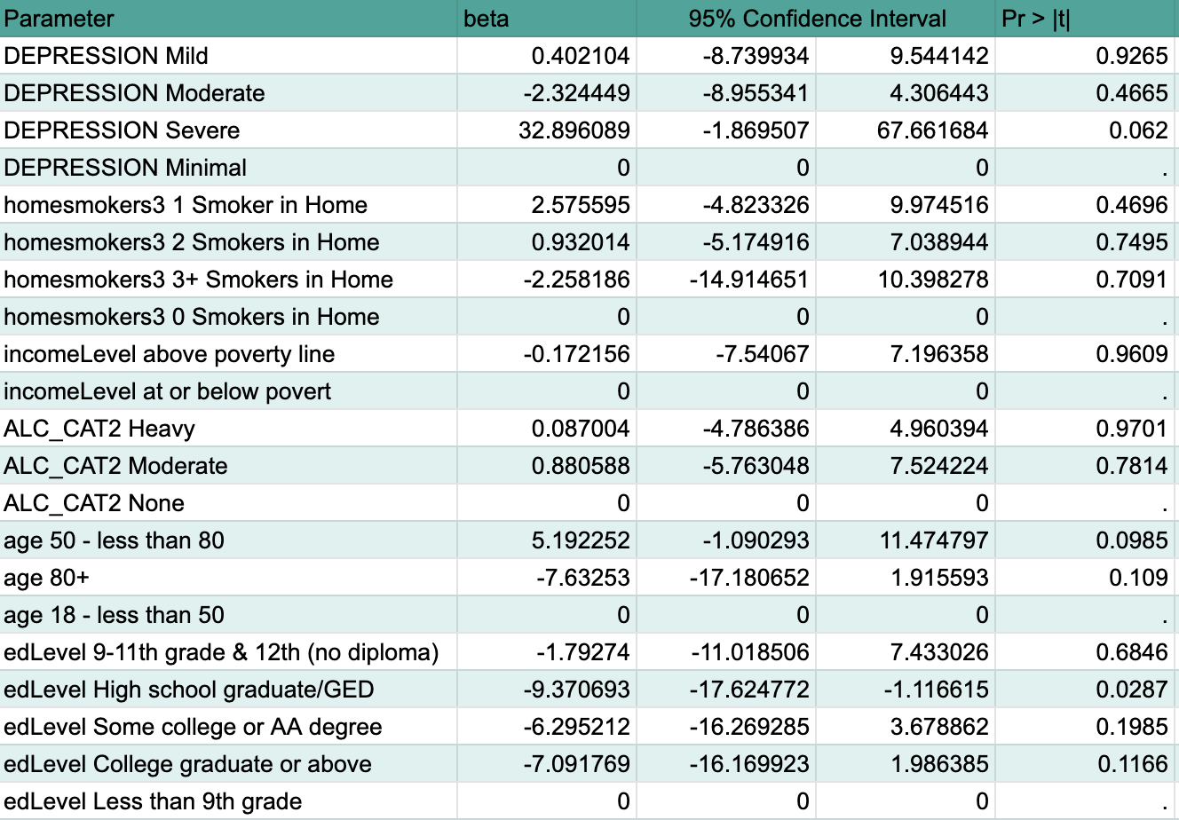
Results: Question 2, Model 2
Exposure: Depressive Symptoms
Outcome: LDL Levels : NIH Equation 2

Slide 27
Conclusions and Implications
Conclusions:
There is no significant association between intensity of depressive symptoms
Diabetes
LDL Levels
A significant association exists between PHQ9 score and passive exposure to smoke.
Implications
Weight implies that our conclusions can be generalized to the population of the entire country
Note:
No subgroup analysis was conducted
Some of our factors could have more complex relationships than what we showed

Slide 28
Next Steps
Educate the general population:
Relay the link between depression symptoms and passive exposure to smoking.
Follow up studies:
Look at the effect that different types of smoke have (marijuana, cigarettes, vape, etc.)
Look at the amount of exposure that is linked to causing depressive symptoms.

Slide 29
Acknowledgements
Thank you to...
Our faculty advisors, Jacqui and Howard, for their guidance and support throughout our research project.
Our TAs, Brooke, Stephanie, and Daniel, for answering many questions and sharing their own experiences.
The SIBS instructors and guest speakers, for introducing us to a variety of biostatistics applications and career opportunities.
The BU SIBS Co-Directors, Jacqui and Anita, for making this experience possible.

Slide 30
Thank You

Slide 31
Questions?

